Slide 1


DUNDER
INC
MIFFLIN,
PAPER COMPANY
SQL for the Developer

Slide 2



As a Developer
Why should you care about SQL?

Slide 3



As a Developer
Why should you care about SQL?
SQL IS
DYNAMIC
Unique Details
FREE
In Power BI Datamarts
USEFUL
Modeling Advantages

Slide 4
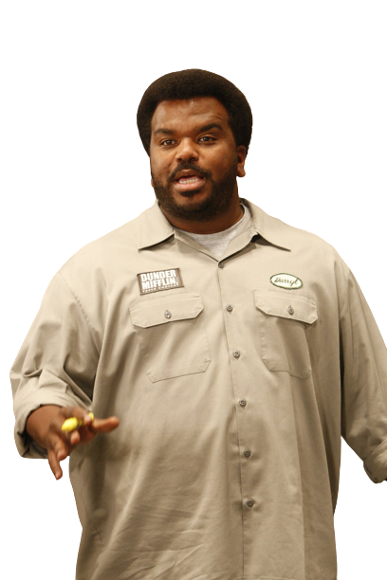

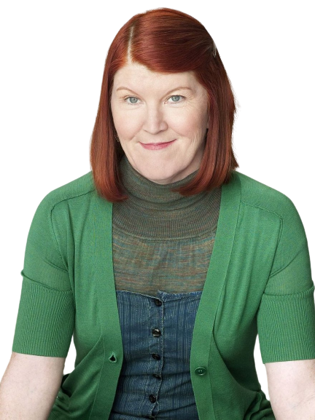
As a Developer
Why should you care about SQL?
SQL IS
UNIVERSAL
Created in 1974
EASY
Select - From - Where
POWERFUL
Research - Validation

Slide 5
As a Developer
Why should you care about SQL?
SQL IS
EASY
Select - From - Where

Slide 6
SELECT

Slide 7
FROM

Slide 8
WHERE

Slide 9
SELECT

Slide 10
FROM

Slide 11
WHERE

Slide 12
SELECT

Slide 13
FROM

Slide 14
WHERE

Slide 15
SELECT

Slide 16
FROM

Slide 17
WHERE

Slide 18










As a Developer
Who is this guy & why do I care?
Chris Wagner
Director Data Solutions
Founder of Kratos BI
Microsoft Data Platform MVP
Analytics Rebel
Future Edge 50 Award Winner

Slide 19


As a Developer
Again, why do I care who this guy is?
Managed Multiple 30k+ Installs
Provided Solution Designs for 1,400 devs
Developed 20k User Reporting Platform
13 Years working with

Slide 20
As a Developer
How do I follow along?

Slide 21

As a Developer
Where do I start?
DB OBJECTS
SERVER – The service running the DB
DATABASE – Organized collection of data
TABLE – Where Data is stored
SCHEMA – Organization for Tables
VIEW – View of Table(s)

Slide 22

As a Developer
Where do I start?
BASIC SYNTAX
SELECT – What you want
FROM – What table(s)
WHERE – Where these conditions match

Slide 23
SELECT

Slide 24
FROM

Slide 25
WHERE

Slide 26
SELECT

Slide 27
FROM

Slide 28
WHERE

Slide 29

As a Developer
Write a Select Statement
TO THE LAPTOP

Slide 30

As a Developer
Where do I start?
AGGREGATION
SUM() – Summarize Data
GROUP BY – What you want to aggregate
ORDER BY – What order you want

Slide 31



As a Developer
Where do I start?
JOIN TYPES
INNER – Where conditions match
LEFT – All of 1, match of other
OUTER – Where conditions do NOT match
INNER
LEFT
OUTER

Slide 32
SELECT

Slide 33
FROM

Slide 34
WHERE

Slide 35
As a Developer
Add an Aggregation and Join
TO THE LAPTOP

Slide 36

As a Developer
Where do I start?
VALIDATION
GROUP BY – What you want to aggregate
ORDER BY – What order you want

Slide 37

As a Developer
Where do I start?
MODELING
FACT TABLES – Some models need a fact
TYPE 1 & 2 Joins – Queries can be easier to manage

Slide 38

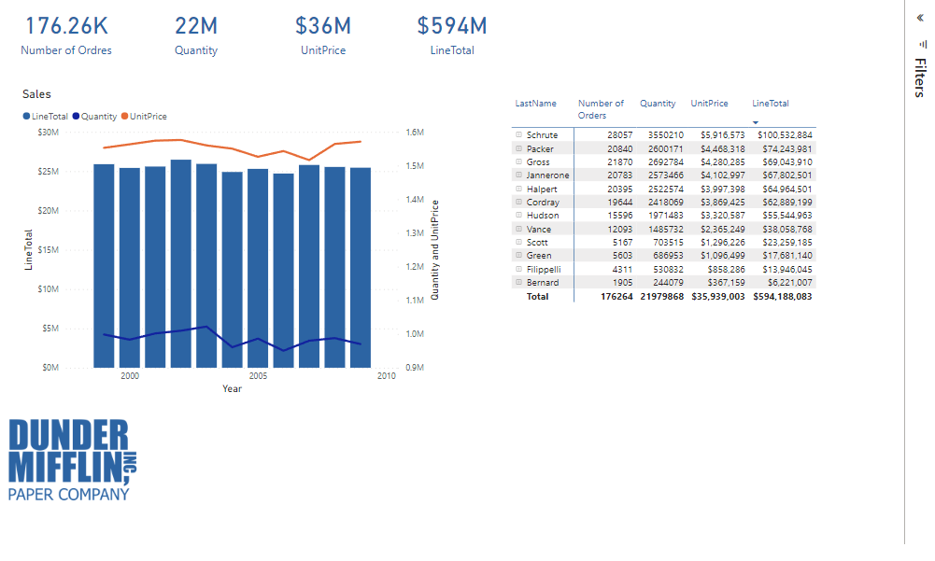
APP DATA MODEL

Slide 39
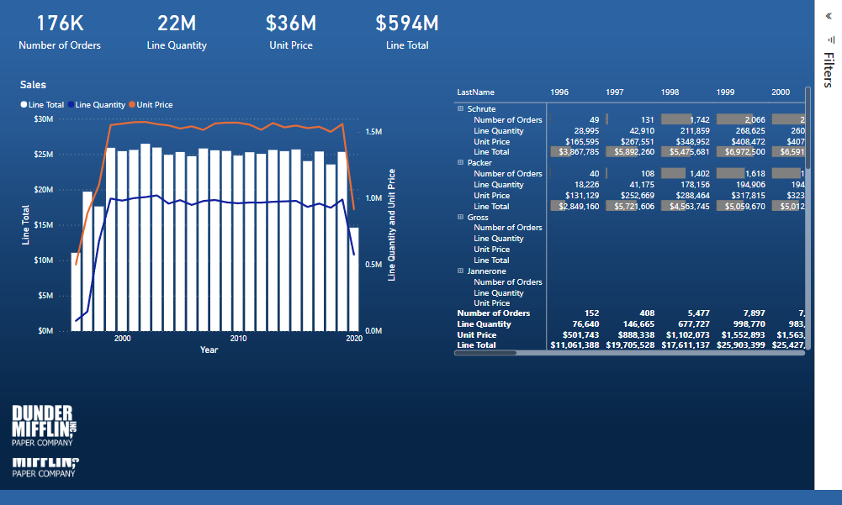
STAR DATA MODEL

Slide 40
DUNDER
INC
MIFFLIN,
PAPER COMPANY
SQL for the Developer

Slide 42
DUNDER
INC
MIFFLIN,
PAPER COMPANY

Slide 43
DUNDER
INC
MIFFLIN,
PAPER COMPANY

